Slide 1
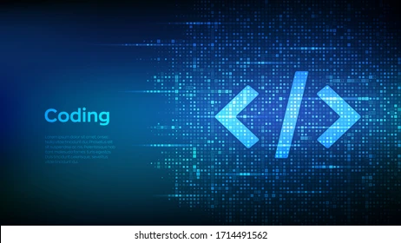
Presentation about array and function in c

Slide 2
FUNCTION IN C
DEFINITION:
Syntax:
Example:
Function is a block of a code. It perform particular task when we call
Return_type function_name(){
// code to be executed }
#include<stdio.h> void lol(){
Int a, b, c;
a=10;
b=10;
c=a + b;
Printf (“The sum of %d and %d = %d”,a ,b ,a+b);
}
Int main(){
lol();
Return 0;
}
ADVANTAGE OF FUNCTION:
1: It reduce the line of a code.
2: We don’t need to write same code again and again.
3: We can run one function again and again.

Slide 3
ARRAY IN C
DEFINITION:
Syntax:
Example:
An array is a collection of data in same data type.
Data_type variable_name[] = {multiple value};
#include<stdio.h> int main()
{
Int a[ ]={1, 2, 3, 4, 5};
Printf (“array: %d”, a[0]);
Return 0;
}
ADVANTAGE OF ARRAY:
1: We can write many value in one variable. 2: We can print all the value of variable at once.
3: Array have low overhead.

Slide 4
MULTI-DIMENSIONAL ARRAY
DEFINITION:
Syntax:
Example:
A multi dimensional array is define as an array which have more than one dimension.
#include <stdio.h>
int main() {
int matrix[2][3] = { {1, 4, 2},{3, 6, 8}};
printf ("%d", matrix[0][2]);
return 0;
}
Data_type variable_name[size1][size2] = {multiple value1}{multiple value2};
ADVANTAGE OF ARRAY:
1: we can solve matrix problem through array.
2: In an array, accessing an element is very easy by using the index number.

Slide 5


